Slide 1
Capstone Engagement
Assessment, Analysis, and Hardening of a Vulnerable System

Slide 2
Table of Contents
This document contains the following sections:
01
Network Topology
02
Red Team: Security Assessment
03
Blue Team: Log Analysis and Attack Characterization
Hardening: Proposed Alarms and Mitigation Strategies
04

Slide 3
Network Topology
‹#›

Slide 4
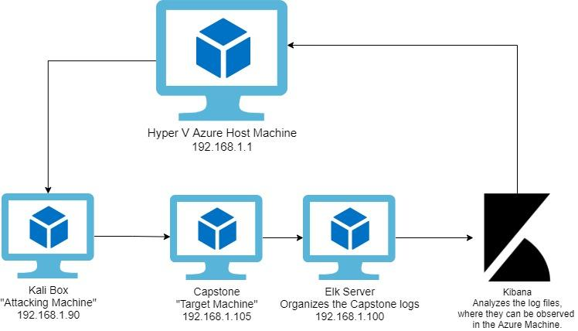
Network Topology
Network
Address Range: 192.168.1.1/24
Netmask: 255.255.255.0
Gateway: 10.0.0.0.76
Machines
IPv4: 192.168.1.1
OS: Windows 10
Hostname: Azure Hyper-V
IPv4:192.168.1.100
OS: Linux
Hostname: ELK
IPv4:192.168.1.105
OS: Linux
Hostname: Capstone
IPv4:192.168.1.90
OS: Linux
Hostname: Kali

Slide 5

Red Team
Security Assessment
‹#›

Slide 6
Recon: Describing the Target
Nmap identified the following hosts on the network:
Hostname | IP Address | Role on Network
Hyper V Azure machine | 192.168.1.1 | The original server which has been split, housing the separate machines/servers below.
ELK Box | 192.168.1.100 | Network Tracker which runs, in this instance, Kibana.
Kali | 192.168.1.90 | Attacker Machine
Capstone | 192.168.1.105 | Vulnerable Web Server

Slide 7
Vulnerability Assessment
The assessment uncovered the following critical vulnerabilities in the target:
Vulnerability | Description | Impact
Port 80 is open, and public facing. | Anyone who wants to potentially gain access to a server is able to by exploitation of web traffic, because port 80 is unrestricted. | An open port can be used to gain access as an attack vector, exploiting vulnerable servers or applications running http traffic over that port.
Brute Force Vulnerability | When an automated wordlist is used to try many different authentication combinations in a condensed span of time. | A Brute Force vulnerability can be used to gain access to part of a server which require authentication for access.
Code Injection | When potentially malicious code is introduced to a system through a weakness in their input validation. | If code from an outside source can be introduced to a server and then run, it offers a
Remote Code Execution | When code that has been injected becomes executed by the target-side interpreter. | Possible access to any and all information on the server.

Slide 8
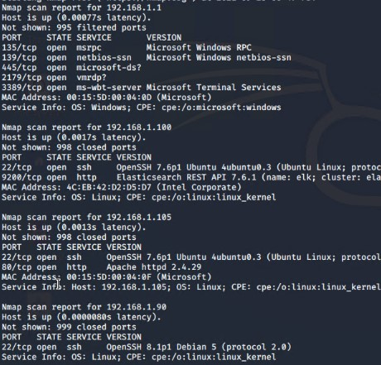
Exploitation: Port 80 Is Open, and Public Facing
01
02
03
Tools & Processes
Used Nmap in order to scan the subnet for machines on the network.
Achievements
Found a machine which was was running HTTP on an open port.

Slide 9
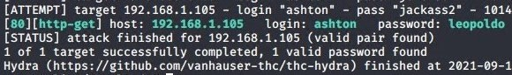
Exploitation: Brute Force Vulnerability
01
02
Tools & Processes
Using hydra and the wordlist rockyou.txt, I bruteforced the hidden directory on the WebDav app.
Achievements
Gave me authentication into the secret folder on the Capstone machine.
03

Slide 10
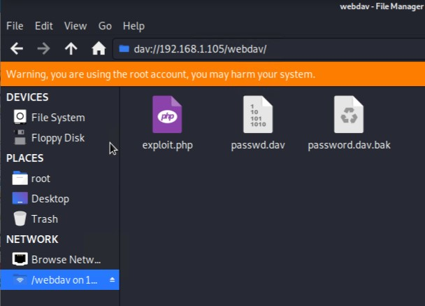
Exploitation: Code Injection
01
02
03
Tools & Processes
Through both brute forcing and interpreting hashes, I was able to gain access to the webdav by establishing file sharing with my Kali box.
Achievements
The exploit allowed for a PHP reverse shell payload to be uploaded to the target machine.

Slide 11
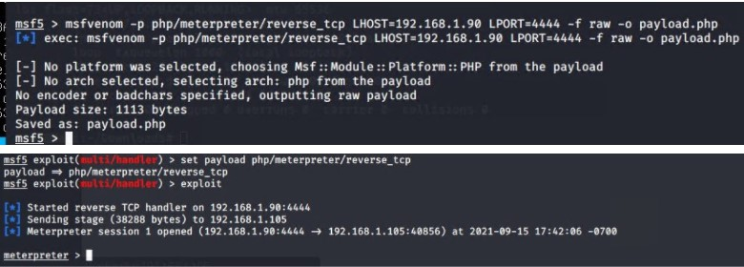
Exploitation: Remote Code Execution
01
02
Tools & Processes
Used msfvenom to create a PHP reverse shell payload which was then copied onto the target machine. When run, connection was established.
Achievements
Granted a user shell into the Capstone VM, with root access.
03

Slide 12

Blue Team
Log Analysis and Attack Characterization
‹#›

Slide 13

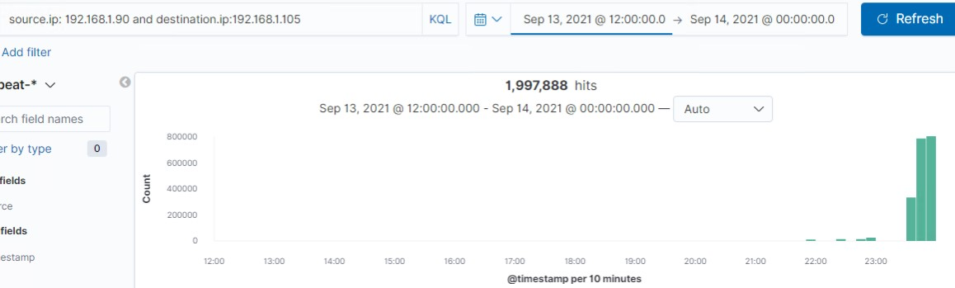
Analysis: Identifying the Port Scan
Answer the following questions in bullet points under the screenshot if space allows. Otherwise, add the answers to speaker notes.
The port scan occurs on Sept. 13, at 23:30 PDT
There were 335,126 packets sent from 198.162.1.90 at the start of the port scan.
The sudden spike in network traffic helps us identify when the port scan took place.

Slide 14
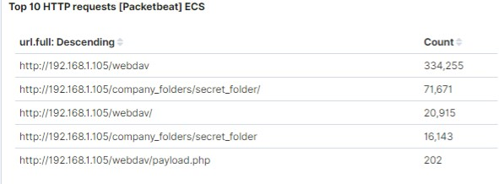
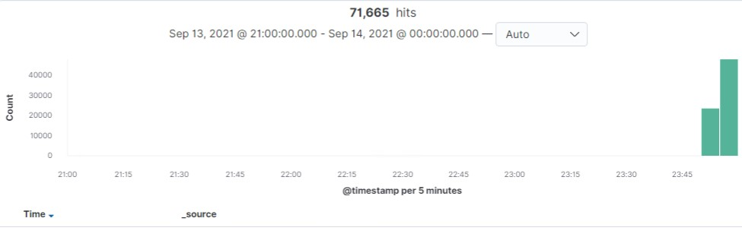
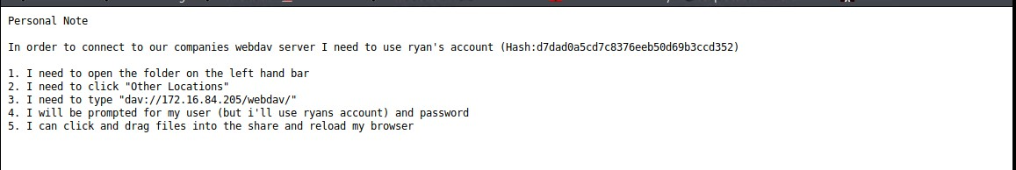
Analysis: Finding the Request for the Hidden Directory
Answer the following questions in bullet points under the screenshot if space allows. Otherwise, add the answers to speaker notes.
There were 71,671 HTTP requests made at 23:50 PDT against the “/company_folders/secret_folder/” on the public facing website. It contained instructions on how to set up local file sharing with the private webdav portion of the website.

Slide 15
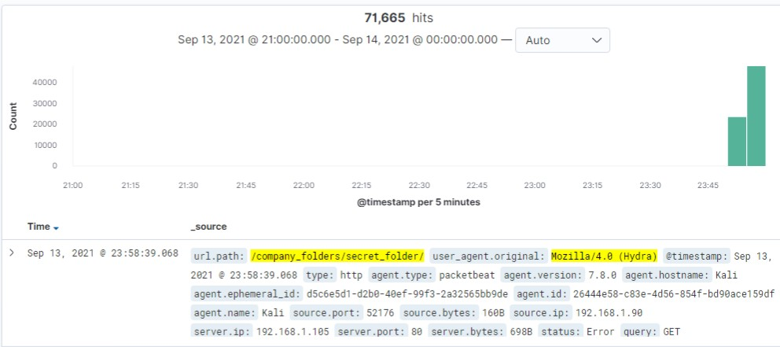
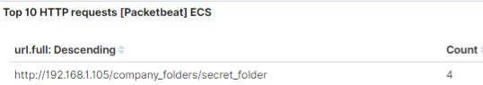
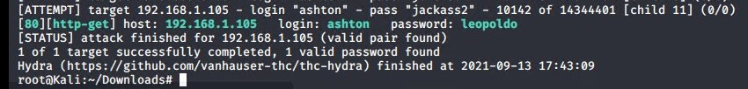
Analysis: Uncovering the Brute Force Attack
71,665 requests were made in the attack. The unusually high number was due to hydra initially being given the wrong user credentials.
Once the correct credentials were given, there were about 10,142 requests made before a successful attempt.
There was 4 successful attempts, being given a 301 response code.

Slide 16
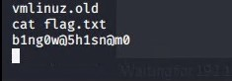
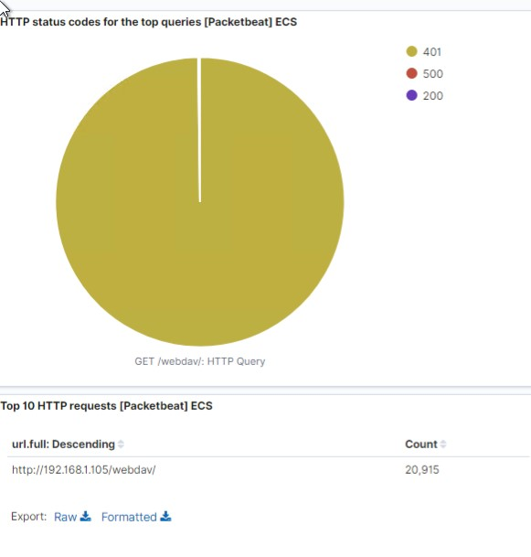
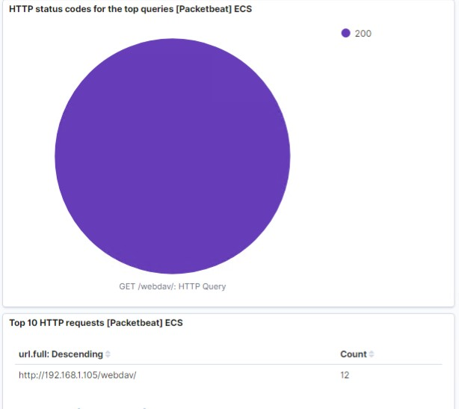
Analysis: Finding the WebDAV Connection
There were in total 20,915 request to the directory. Only 12 of those were successful.
The passwd.dav and the exploit.php file were the most requested files.
The flag:

Slide 17
Blue Team
Proposed Alarms and Mitigation Strategies
‹#›

Slide 18
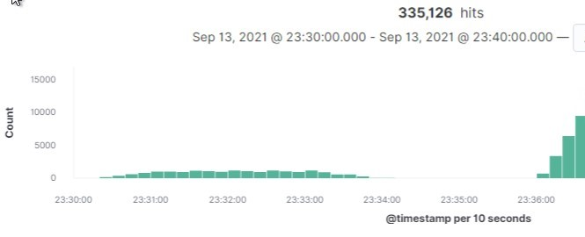
Mitigation: Blocking the Port Scan
What kind of alarm can be set to detect future port scans?
An alarm can be set to notify the admin every time HTTP requests go past the 1000 mark.
In order to mitigate port scans, conduct your own private port scans to make sure that there are no open accessible ports.
Install a firewall which can control which ports are open, as well as redirect port scan traffic.

Slide 19
Mitigation: Finding the Request for the Hidden Directory
What kind of alarm can be set to detect future unauthorized access?
Any 10 consecutive failed authentications triggers an alert to the administrator.
Only allow access to the hidden directory through a company VPN which itself requires two factor authentication to access.
Remove the directory from any search listings.
If you’re working on an Apache web server, on your .htaccess file you can add line “Options -Indexes”, which will disable the directory listings on your site. The directory will not be accessible, because it has no index file.

Slide 20
Mitigation: Preventing Brute Force Attacks
What kind of alarm can be set to detect future brute force attacks? An alarm triggers after 10 consecutive failed authentications.
Restrict the amount of failed login attempts that can take place.
Use Capitcha
Limit login attempts to only specified IP addresses.
Make root capabilities inaccessible via shell through editing the sshd_config file.
Regularly check the logs for abnormal activity.

Slide 21
Mitigation: Detecting the WebDAV Connection
What kind of alarm can be set to detect future access to this directory?
Allow access to a pre-specified list of IP addresses. If any of these IP addresses registers a PUT request, send an alert and automatically restrict the user.
Only allow authentication to specific IP addresses.
Set the WebDav to only have read access to the majority who authenticate, with write privileges to only a singular few IP addresses.
Allow access to WebDav only from a local area network, and not any external networks.

Slide 22
Mitigation: Identifying Reverse Shell Uploads
What kind of alarm can be set to detect future file uploads?
Alert if any executable files are uploaded, or if any non executable files (images, etc,.) increase the amount of space they take in comparison to when they were initially uploaded. Long strings within files can indicate encoding.
Set up the host to block any executable files from being uploaded.
Allow only specific file types to be uploaded.
Require authorization to upload files.
Store any uploaded files in an area that is not web-accessible.
Scramble file names and extensions that are uploaded to prevent any type of execution.

